Slide 1
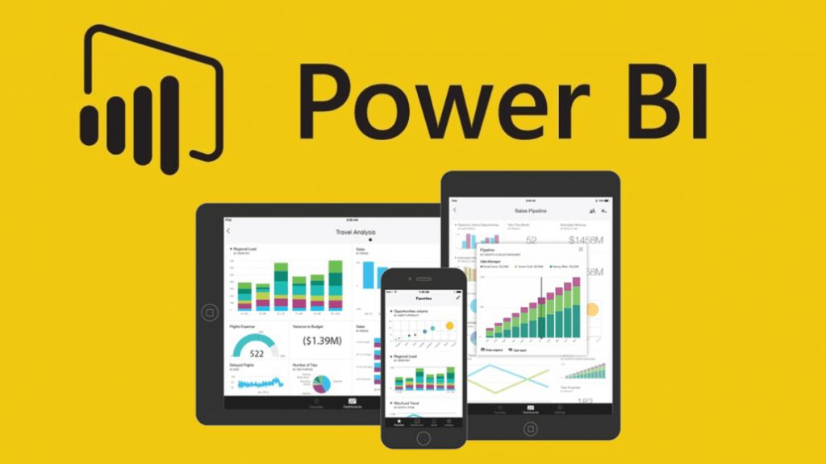

Power BI Dataset refresh architecture
Generic architecture for refreshing data
Azure Data Factory
Power BI
Source Data
ETL
EDW
Power BI Datasets
Cloud
Refresh PBI Datasets via REST APIs
Power BI Dataset
Land Data
DB
Process Data
Read
Power BI Dataset
Text
Power BI Dataset
Failure Notification
Details on next slide

Slide 2
Ideal PBI Dataset refresh process (future)
O365 Tenant
MAX Tenant
1
Power BI Service
ADF Pipeline
Trigger Refresh
Dataset
Teams Failure Notification
If Refresh Fails
2

Slide 3
PBI Dataset refresh workaround process (PLAN B)
O365 Tenant
MAX Tenant
3
Power BI Service
1
2
Trigger Refresh
ADF Pipeline
Logic App
ADF Pipeline
Dataset
HTTP Request
Kick Off Pipeline
Refresh Status
If Refresh Fails
4
Teams Failure Notification
5

Slide 4
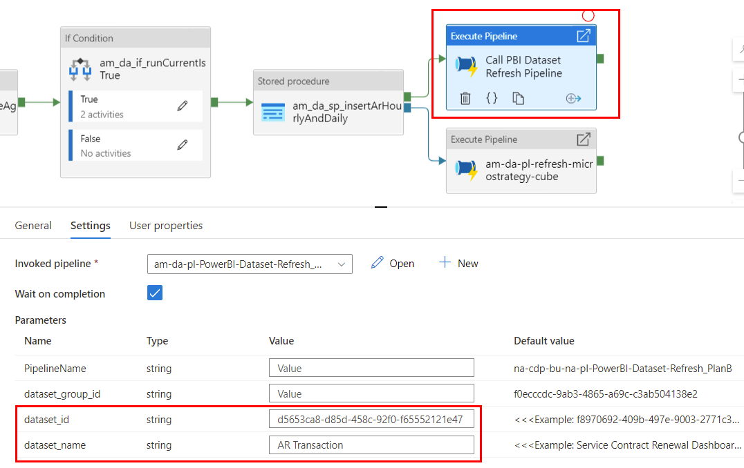
How to Refresh pbi dataset within adf pipeline

Slide 5
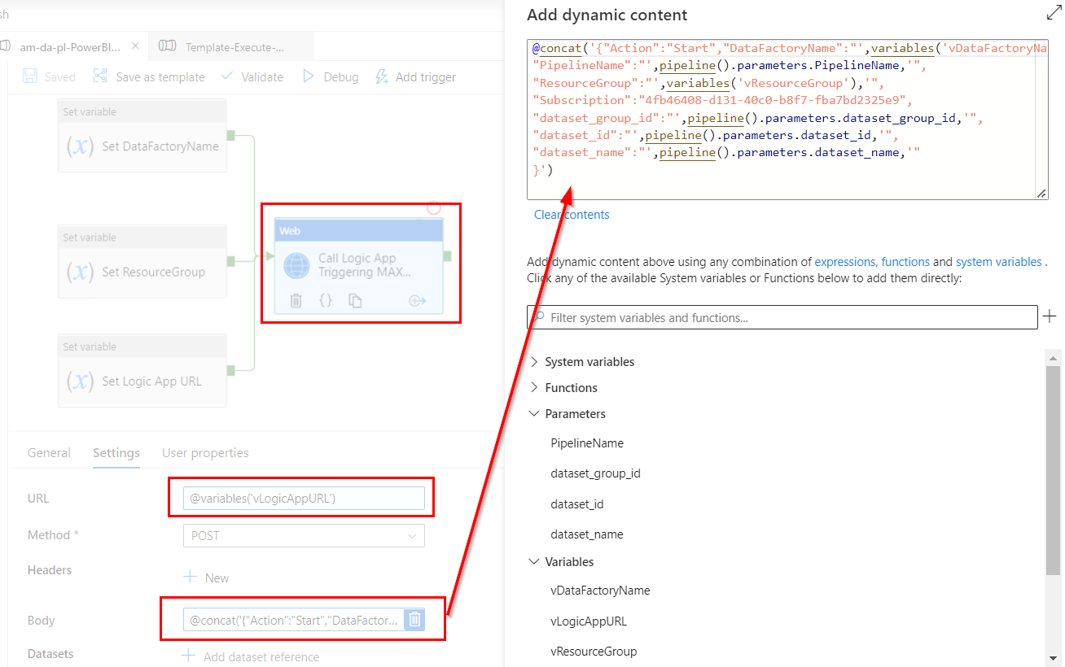
Logic app is used to kick off adf pipeline in another azure tenant (max)

Slide 6
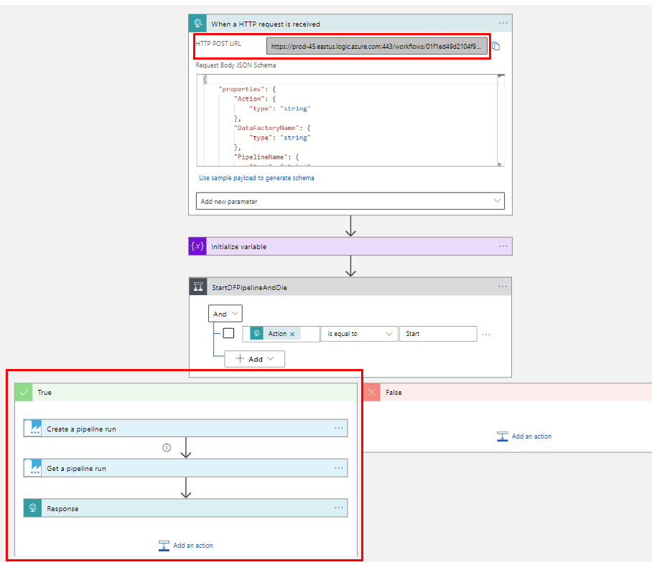
Logic app

Slide 7
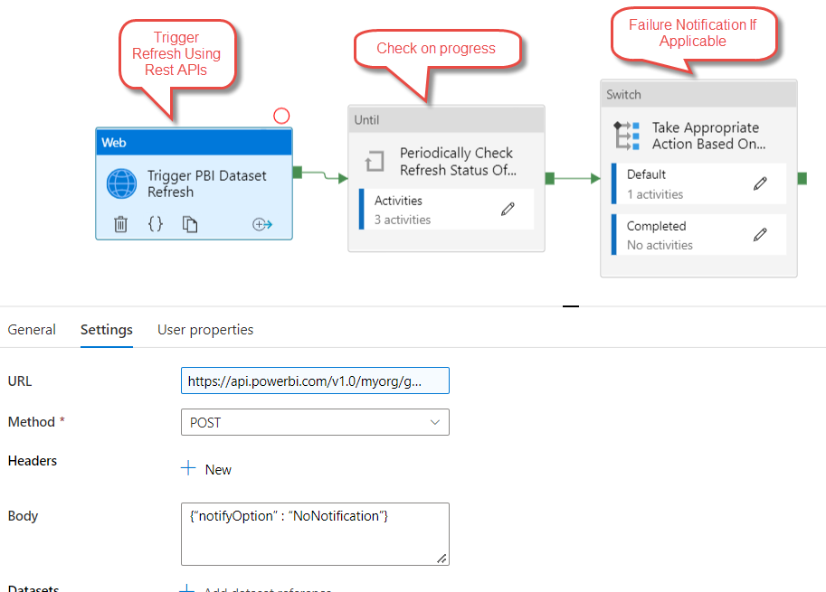
Programmatic power bi dataset refresh FROM ADF

Slide 8
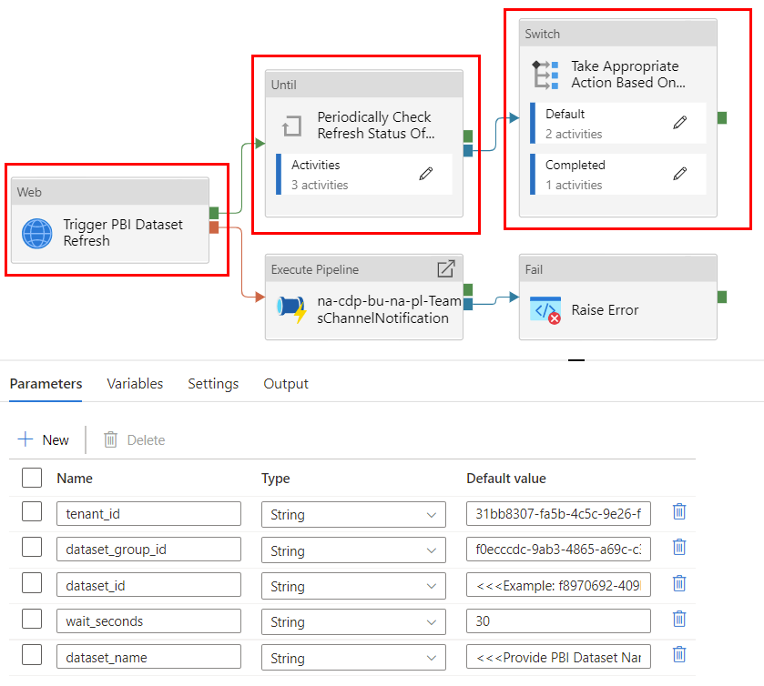
Programmatic power bi dataset refresh FROM ADF with failure notification

